Slide 1
What is SQL? Features And Benefits
SQL is declarative language used to interact with relational databases.
It is used to manipulate and retrieve data, create and modify database structure, and define access control.
SQL is an effective standardized programming language for managing, accessing, or manipulating relational databases and performing different operations.
In 1986 SQL is standardized by the International Organization for Standardization (ISO) and American National Standards Institute (ANSI).

Slide 2
What is SQL? Features And Benefits
SQL is an acronym for Structured Query Language.
SQL can manage and manipulate data like updating, deletion, insertion based on a relational database management system.
SQL is popular and widely used is because it is user-friendly and easy to understand.
With SQL, it is easier to create new tables ,dropping or deleting previously created tables.

Slide 3
What SQL Can Do
SQL can set permissions on views, tables, and procedures
SQL can execute queries against databases
SQL can create new databases
SQL can create views in a database
SQL can create solid stored procedures in a database
SQL can create new tables in a databases
SQL is capable of deleting records from a database
SQL is capable of inserting records into a database
SQL can also retrieve data from a database
SQL can update records in a database

Slide 4
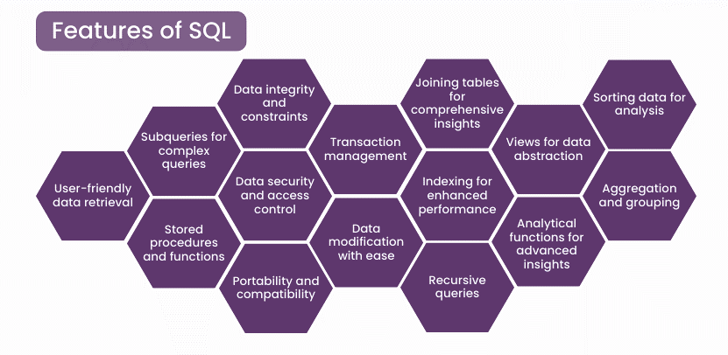

Slide 5
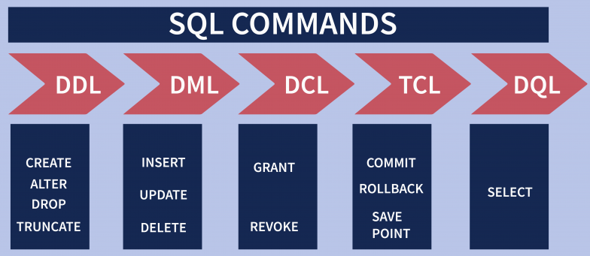
Types of SQL Commands
There are five types of SQL commands: DDL, DML, DCL, TCL, and DQL.

Slide 6
1. Data Definition Language (DDL)
DDL changes the structure of the table like creating a table, deleting a table, altering a table, etc.
All the command of DDL are auto-committed that means it permanently save all the changes in the database.
CREATE
ALTER
DROP
TRUNCATE

Slide 7
MYSQL>CREATE TABLE EMPLOYEE
(
Empid INT,
Name VARCHAR(20),
Email VARCHAR(100),
salary DECIMAL(5,2),
DOB DATE
);

Slide 8
DROP: It is used to delete both the structure and record stored in the table
MYSQL> DROP TABLE EMPLOYEE; -- schema + data gets deleted
TRUNCATE: It is used to delete all the rows from the table and free the space containing the table.
MYSQL> TRUNCATE TABLE EMPLOYEE;
-- only data gets deleted(all data) schema remains in the memory;

Slide 9
ALTER: It is used to alter the structure of the database. This change could be either to modify the characteristics of an existing attribute or probably to add a new attribute.
To add a new column in the table
MYSQL> ALTER TABLE STUDENT ADD(ADDRESS2 VARCHAR(20));
To modify existing column in the table:
MYSQL> ALTER TABLE STUDENT MODIFY (NAME VARCHAR(20));
.

Slide 10
The ALTER TABLE statement is used to add, delete, or modify columns in an existing table.
MYSQL> ALTER TABLE emp ADD Email varchar(25);
OR
MYSQL> ALTER TABLE emp ADD (Email2 varchar(55));
MYSQL>ALTER TABLE emp ADD column Address char(30);
MYSQL>ALTER TABLE emp ADD(fname varchar(55), lname varchar(10),mname varchar(20));
Optional

Slide 11
MYSQL> ALTER TABLE emp ADD column AA int, ADD column BB varchar(20),ADD column CC char(30);
DROP columns from Table
MYSQL> ALTER TABLE EMP Drop LName;
MYSQL> ALTER TABLE EMP Drop column MName;
MYSQL> ALTER TABLE EMP Drop column FName;
MYSQL> alter table emp drop Salary, Age; ERROR
MYSQL> alter table emp drop (Email,DOB); ERROR
MYSQL> alter table emp drop B,drop ADD2; OK

Slide 12
RENAME TABLE Statement
MYSQL> rename table OLDName to NEWName ;
MYSQL> rename table old1 to new1,old2 to new2;

Slide 13
Modify columns of a table
MYSQL> ALTER TABLE EMP Drop LName;
MYSQL> ALTER TABLE EMP Drop column MName;
MYSQL> ALTER TABLE EMP Drop column FName;
MYSQL> alter table emp drop Salary, Age; ERROR
MYSQL> alter table emp drop (Email,DOB); ERROR
MYSQL> alter table emp drop B,drop ADD2; OK

Slide 14
MYSQL> SHOW FULL COLUMNS FROM persons2;

Slide 15
The ALTER TABLE statement is also used to add and drop various constraints on an existing table

